Slide 1
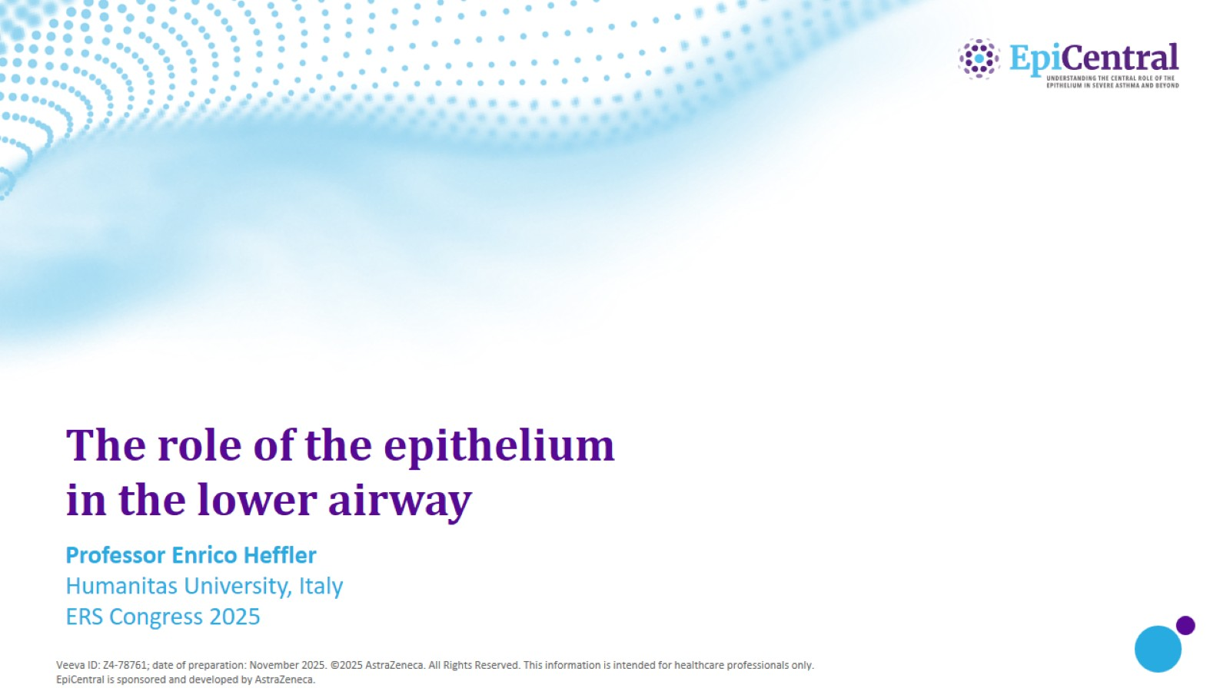
The role of the epithelium in the lower airway

Slide 2
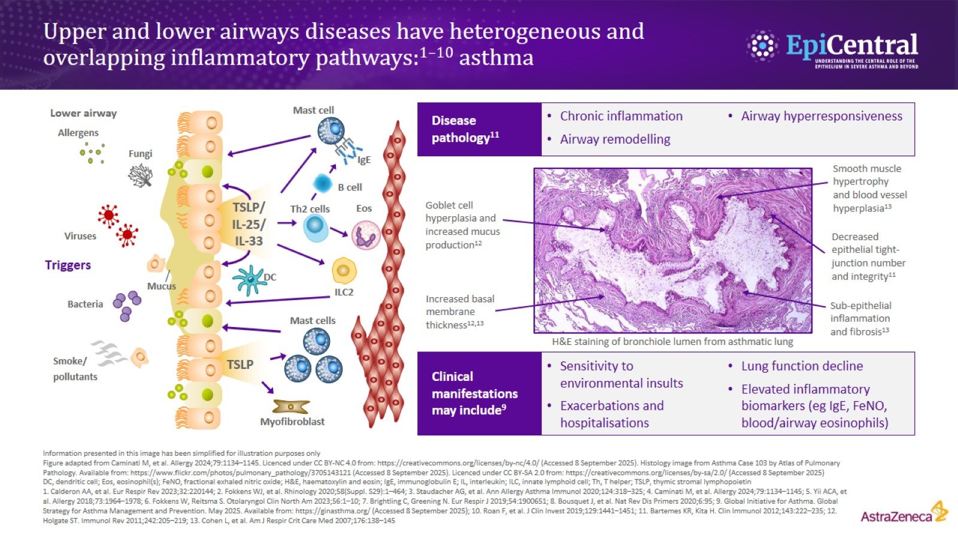
Upper and lower airways diseases have heterogeneous and overlapping inflammatory pathways:^{1–10} asthma

Slide 3
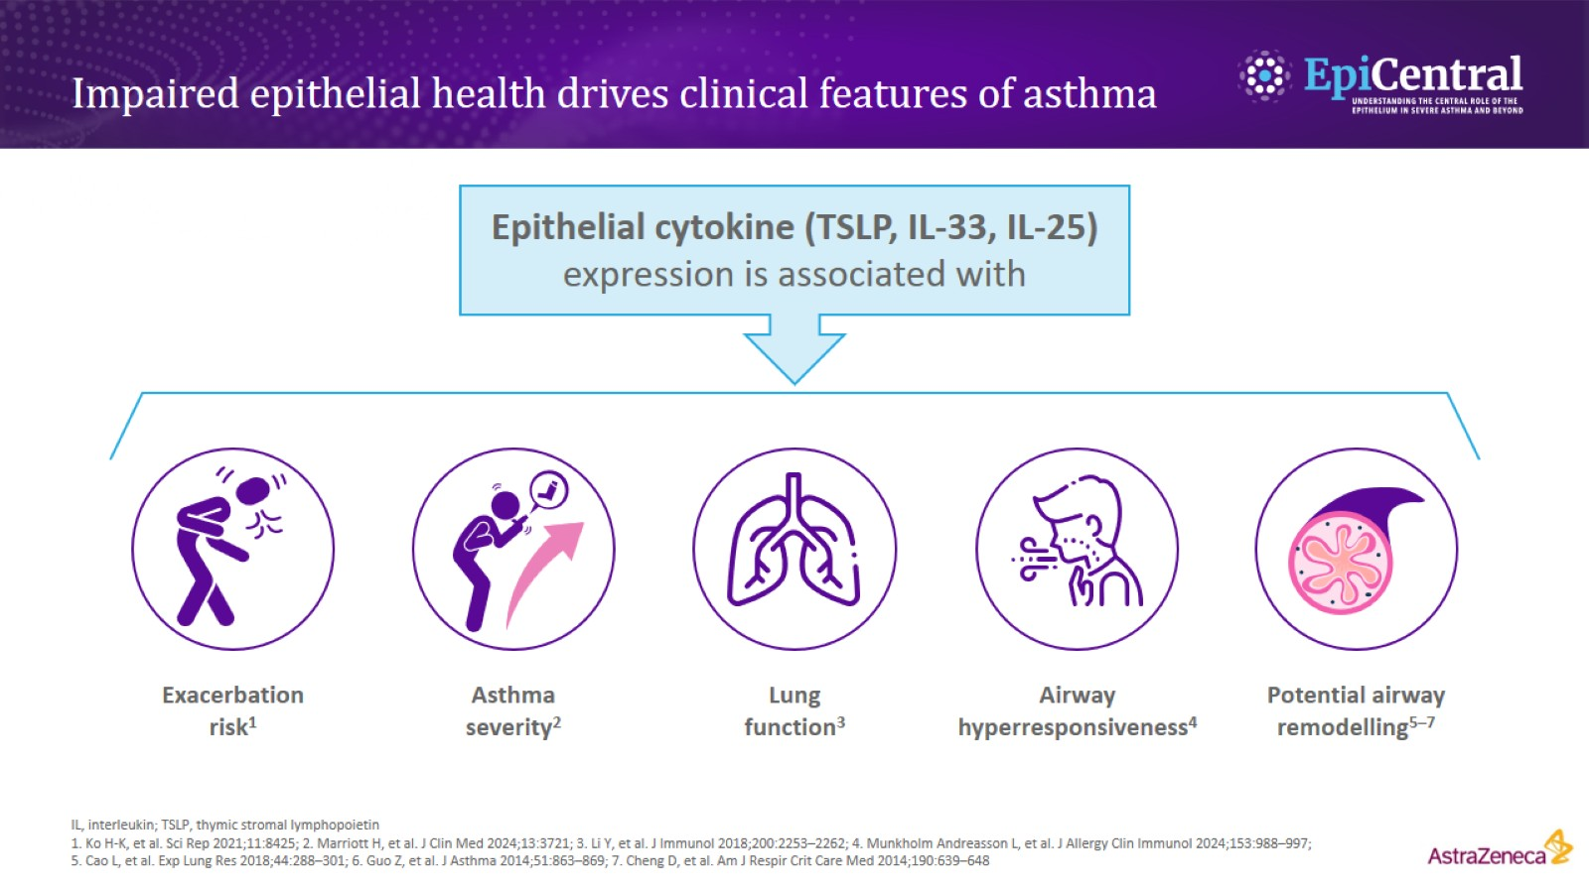
Impaired epithelial health drives clinical features of asthma

Slide 4
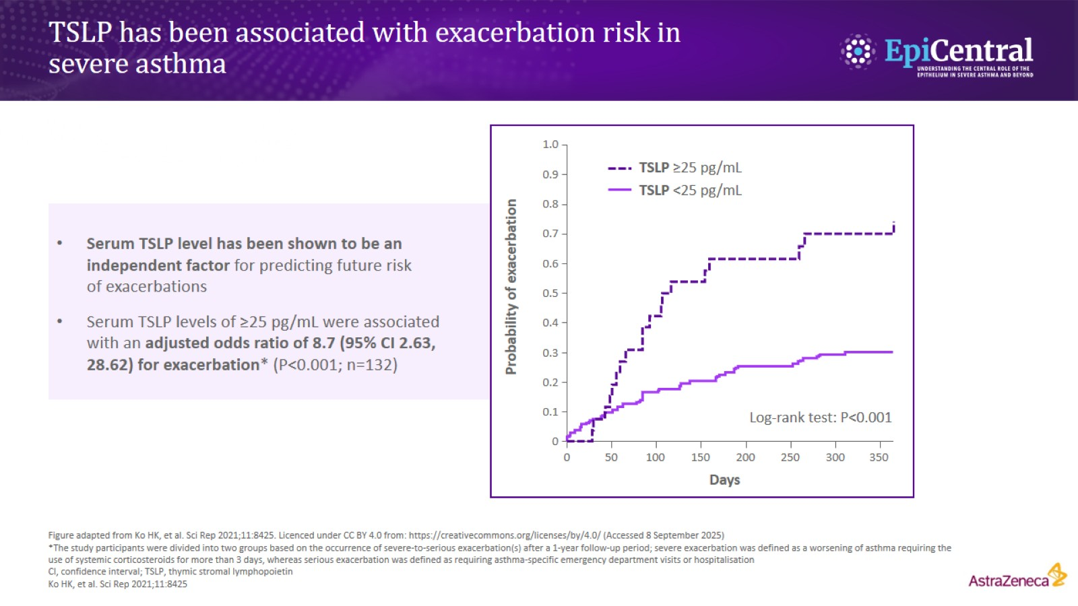
TSLP has been associated with exacerbation risk in severe asthma

Slide 5
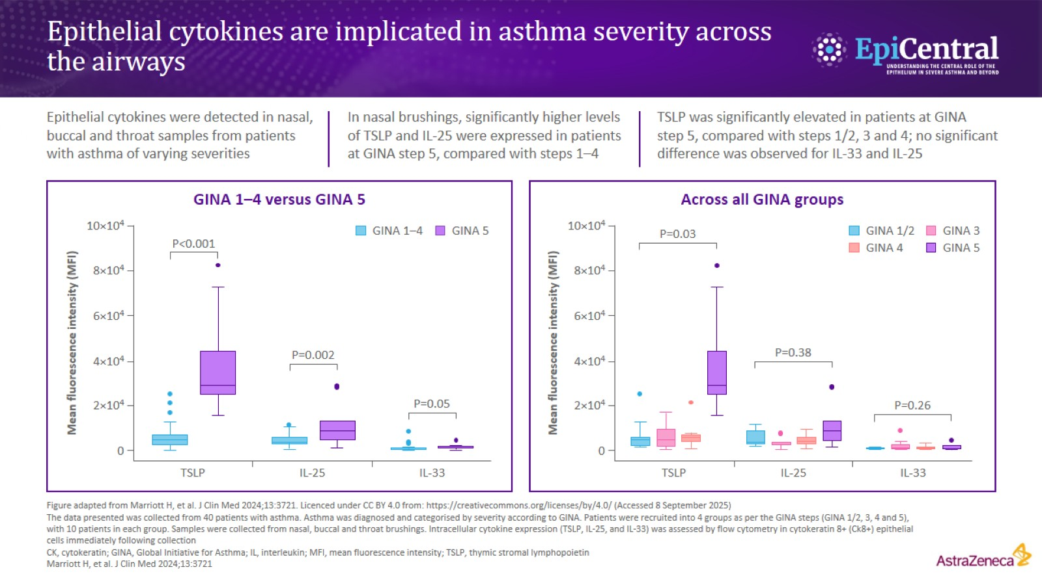
Epithelial cytokines are implicated in asthma severity across the airways

Slide 6
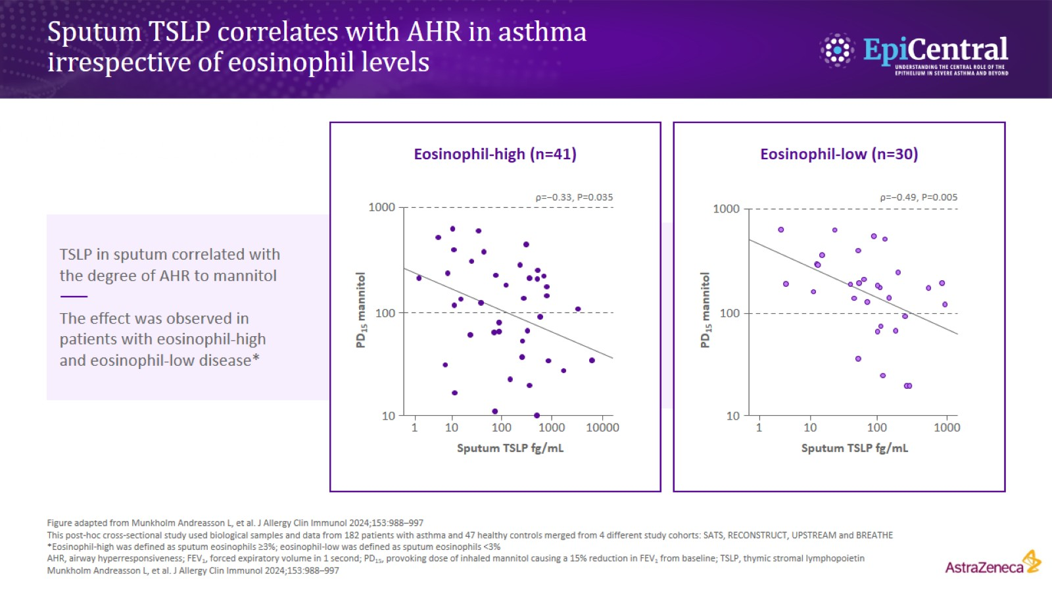
Sputum TSLP correlates with AHR in asthma irrespective of eosinophil levels

Slide 7
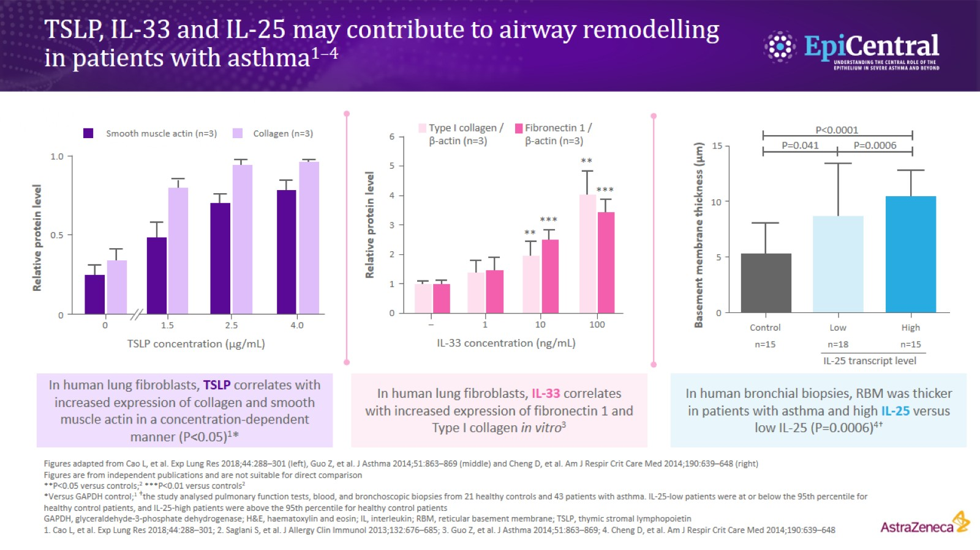
TSLP, IL-33 and IL-25 may contribute to airway remodelling in patients with asthma^{1–4}

Slide 8
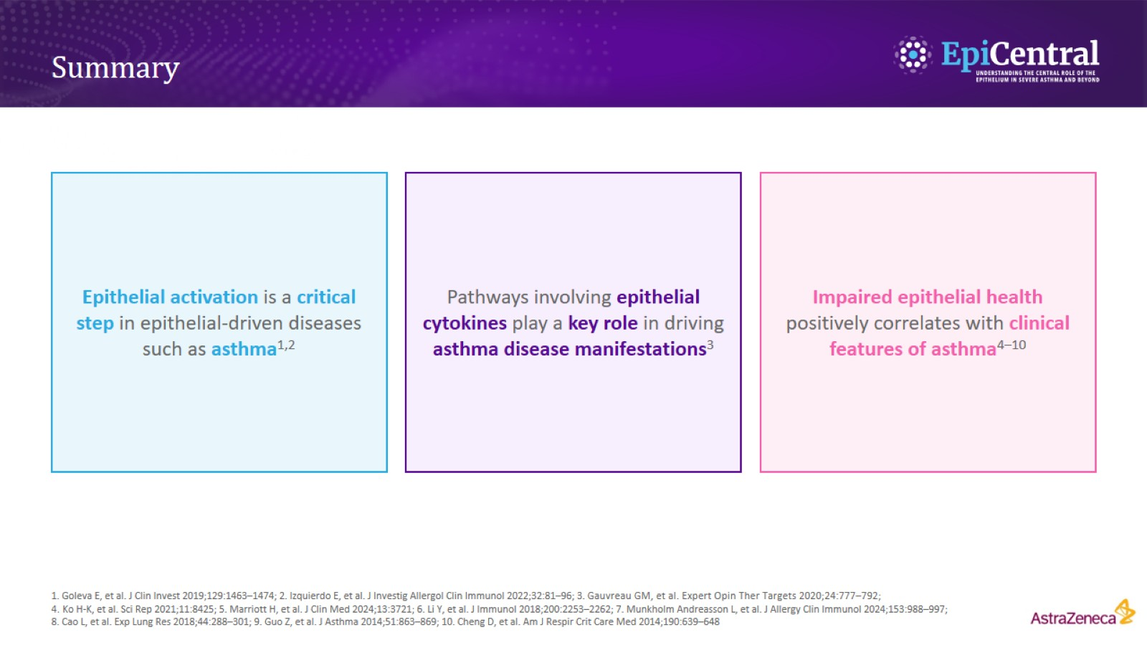
Summary

Slide 9
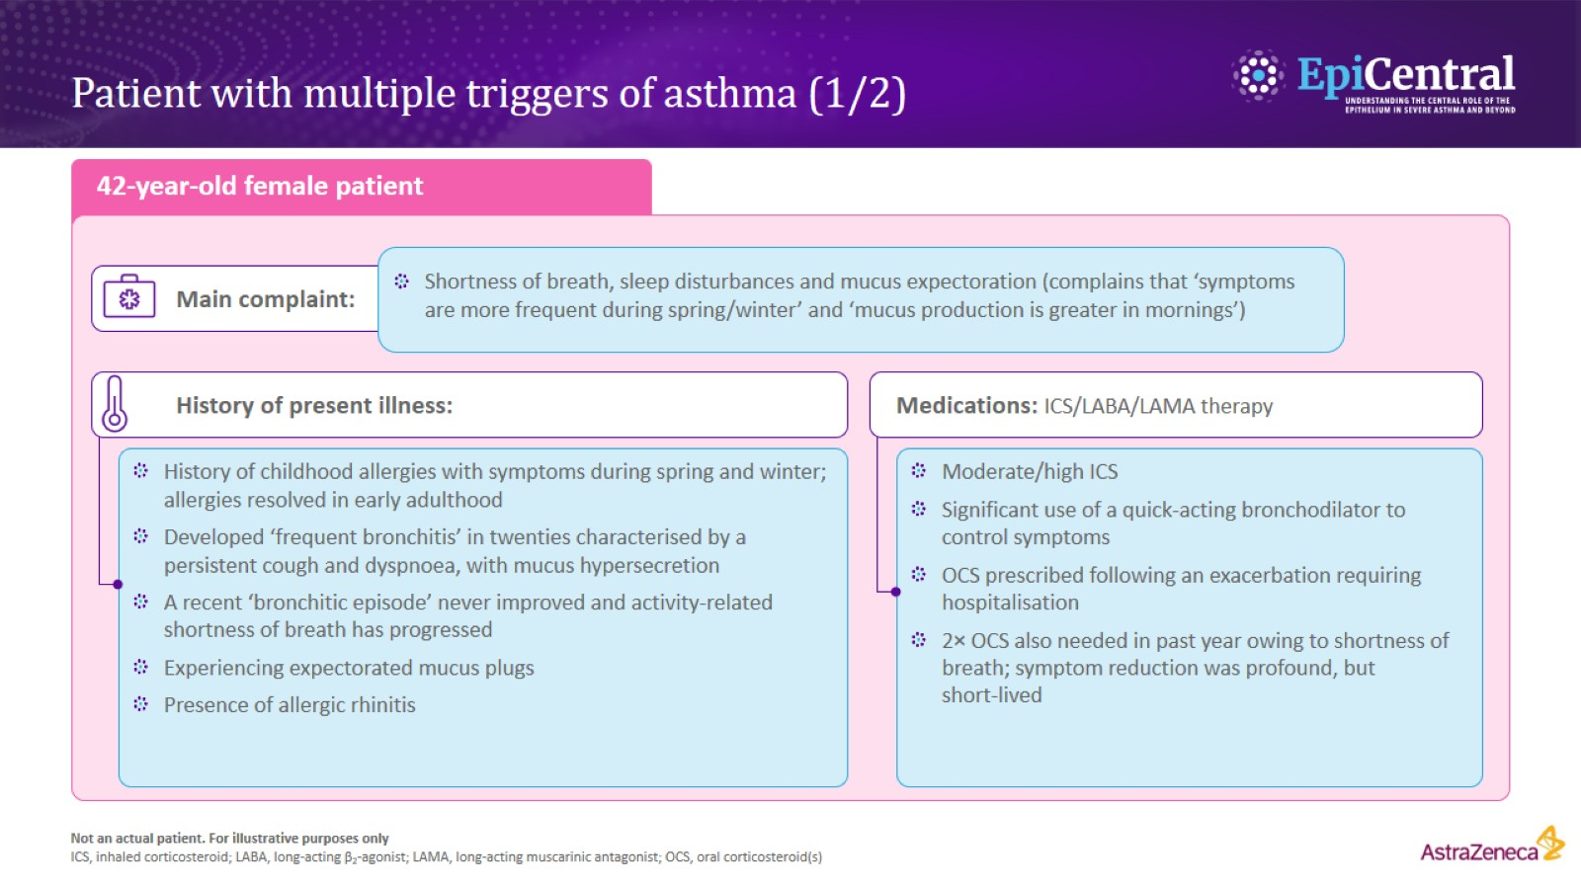
Patient with multiple triggers of asthma (1/2)

Slide 10
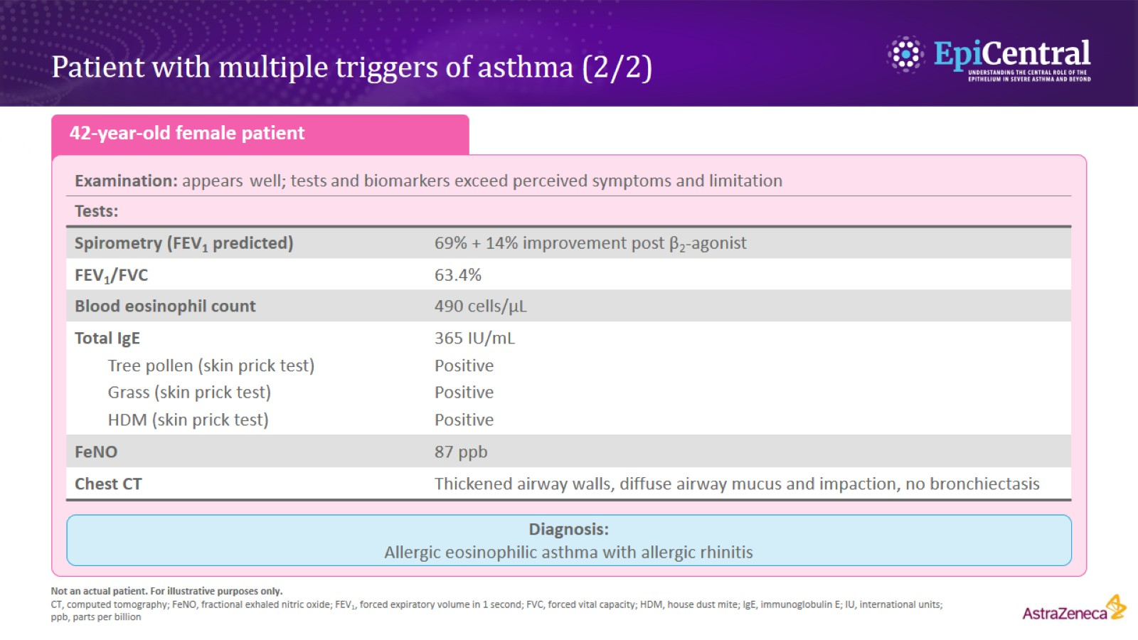
Patient with multiple triggers of asthma (2/2)

